Slide 1

Bioada
POLYGENIC SCORE AND BIOMARKERS DISCOVERY MADE EASY!
Mentor:
Dr. Saed Sayad
Group 2: Sai Mounica Pothuru
Chaitanya Sharma
Harshini Bonam
Kaushal Patel
Vraj Shah

Slide 2
What is Bioada?
An End-to-End Machine Learning Platform for Polygenic Score Prediction & Biomarkers Discovery
Notes:
What is Bioada?
We say, Bioada is the -Ultimate -E2E -ML platform - for polygenic score and biomarkers discovery
We know that / Let me brief you on what biomarkers and polygenic scores are...
Biomarker are the - Objective indications of a medical state - which can observed from outside the patient
Say, by examining the Blood, Urine, or Sputum, etc. We also agree that, Biomarkers are so crucial for clinical study as they can be Measured
-Accurately and -Reproducibly
But discovering such markers takes significant amount of time depending on - the type of system and - data under evaluation.
Coming to Polygenic Score or Polygenic risk score, it is a number that reflects a person’s inherited susceptibility to a disease.
Polygenic Score as a biomarker can help us by - early identification of those who are at increased risk of a clinical disease prior to the manifestation of traditional indicators.
The data that talks about inherited qualities of living thing is nothing but our genomics data.

Slide 3

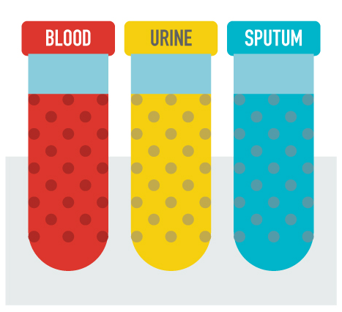

Biomarkers & Polygenic Risk Score
Biomarker or biological marker refers to
Objective indications of medical state observed from outside the patient
Measured
Accurately
Reproducibly

Slide 4
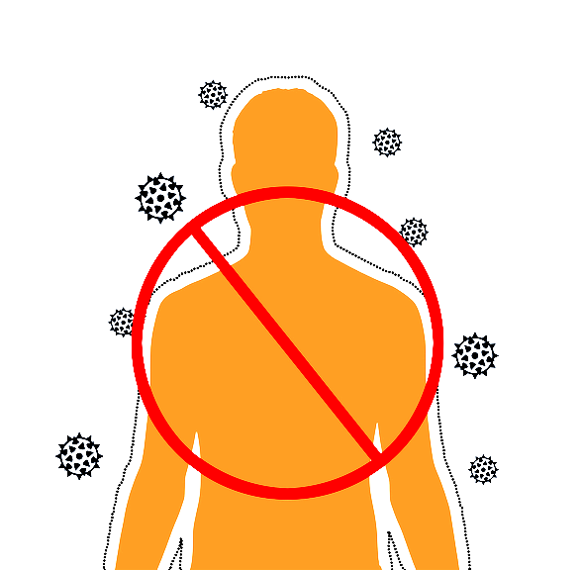



Biomarkers & Polygenic Risk Score
Polygenic risk score (PRS) or Polygenic score
reflects a person’s inherited susceptibility to a disease.
⇒ PRS is a Biomarker for early identification of those at increased risk prior to manifestation of traditional indicators of clinical diseases
27%
11%
15%
XY.Z% (predicted PRS)

Slide 5

Understanding the problem
The scientific community is continuously trying to improve their understanding of genetic mechanisms in biological systems. With growing accessibility, still, only the minority of investigators in the life and medical sciences has the means to analyze and leverage this enormous treasure of data.
Bioada is an integrated, easy to use and interactive genomics data analysis platform for the broader community of life scientists.
Notes:
Now, having the data and the technique to use this data for a desired results, seems obvious.
Then Why Bioada? Let us take a deeper look into the problem
the scientific community is always trying to improve their understanding of the genetic mechanisms In the living systems, Although we have great accessibility to the required data Only a minority of investigations in the field of life and medical sciences Have the means to Analyze and Leverage this enormous data. So Bioada is not just any Machine Learning platform to assist PRS and Biomarkers discovery but - an integrated - easy to use and - an interactive Genomics data analysis platform For the broader community of life scientists.

Slide 6
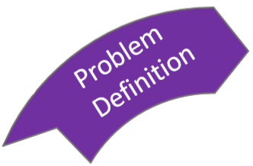




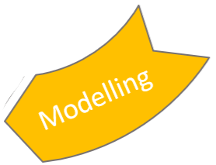
Bioada - 6 step methodology to build PRS model
1
2
6
3
5
4
Notes:
Bioada comes with a simple 6 steps methodology to build an E2E PRS models.
It starts with the
Problem definition, and
Data preparation,
Data exploration,
modelling, and next comes
Model evaluation
And finally model deployment
Following this 6 step methodology, let us look at the following case studies

Slide 7
Step 1 - Problem Definition
To build an interactive web application with,
Input: Genome data
Output: PRS Model and Biomarkers
Algorithm: XGBoost

Slide 8
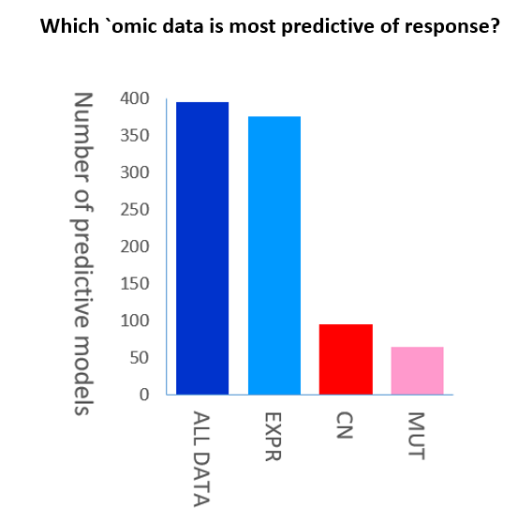
Types of input data
Bioada platform can analyse the following genomic data:
SNP (GWAS)
Copy Number
Gene Expression (RNA-seq and Microarray)
Notes:
Defining our problem statement
The first case study is
To predict Pancreatic cancer from Gene Expression data.
And the second case study is
To predict gastric cancer from GWAS data.
In the next step

Slide 9
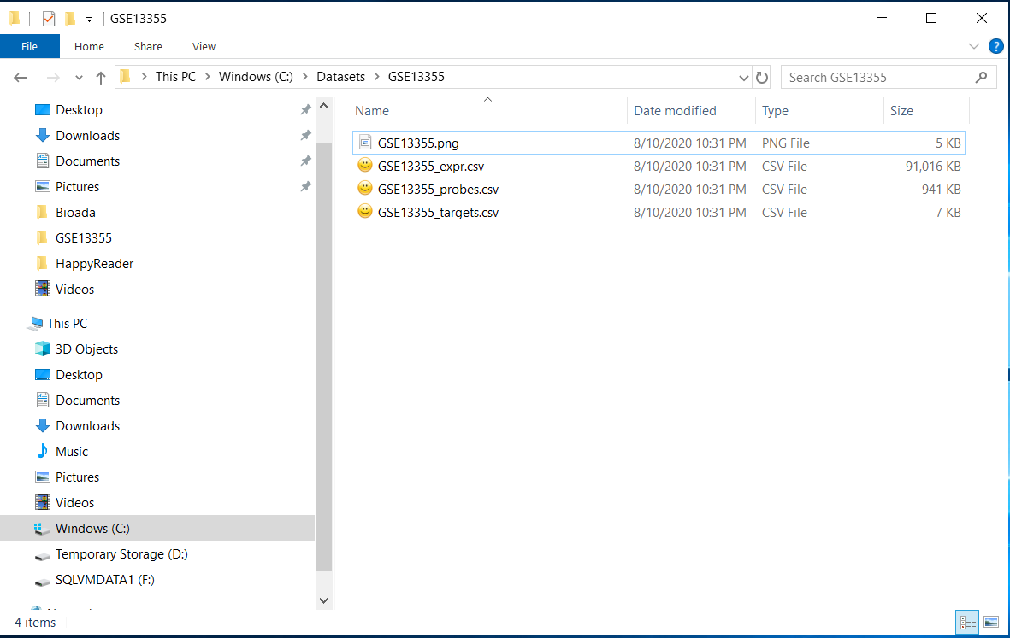
Data File Structure

Slide 10
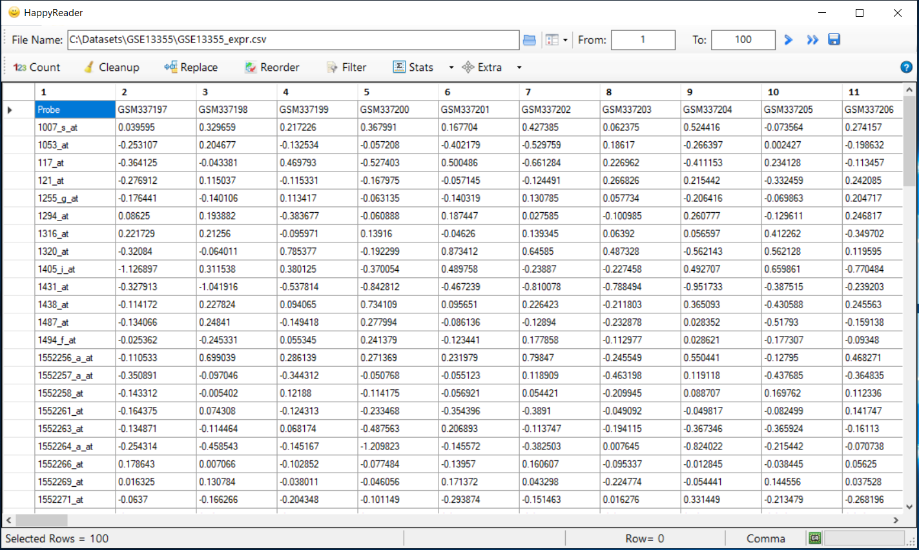
Expression File

Slide 11
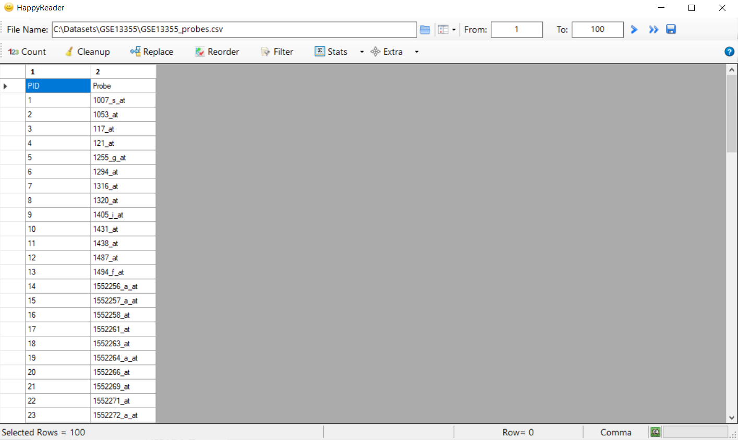
Probe File

Slide 12

Target File

Slide 13
Step 2 - Data Preparation
We need 3 files namely: expression, probe, target.
We can get the required data directly from https://www.ncbi.nlm.nih.gov/geo/query/acc.cgi
R-tool which will help us gather the data.
Notes:
Genomics data, almost all the time, is in the form of files, flat files.
Which are huge in size.
If a team of scientists have to work on this data these files have to be - shared - managed - and their results at every milestone during the progress Have to merged and again be shared… This process continues… Clearly, this manual process will create too much discordance due to - incorrect data - inconsistent data - or even missing data - and without any secure recovery methods this could be a permanent loss of the progress so far, and calls for a re-work.
So starting from these impediments, SmartArray Manages all this flat file data in a Database…
Maintaining data integrity and consistency
Reducing data redundancies and
Providing robust data security and recovery
All together, significantly improving the overall productivity.

Slide 14
Step 2 - Data Preparation Database Management System
Genomic data in database not flat files
Data Integrity & Consistency
Reduced Data Redundancy
Robust Data Security & Recovery
Significant improvement in productivity

Slide 15
Step 2 - Data Preparation Database Management System
DBMS- Microsoft SQL Server
600 columns per expression fact table
Can be further upgraded to MongoDB in future for better handling of data

Slide 16
Step 2 - Data Preparation
 | Samples
Probes | GWAS / Expression
Samples
Probes

Slide 17
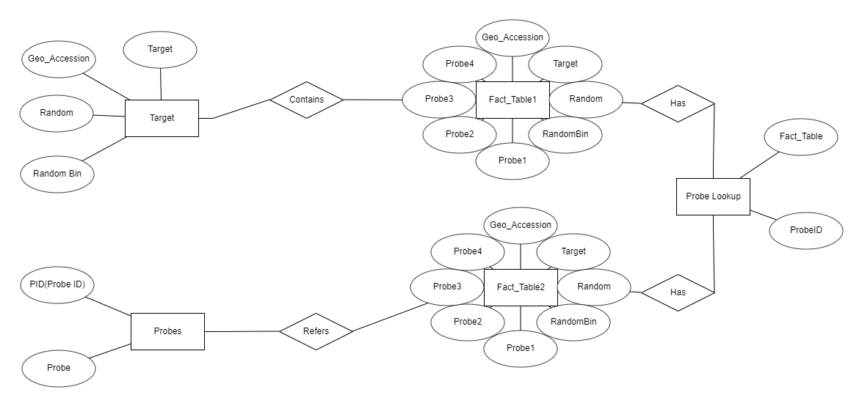
Step 2 - Data Preparation Database Management System

Slide 18
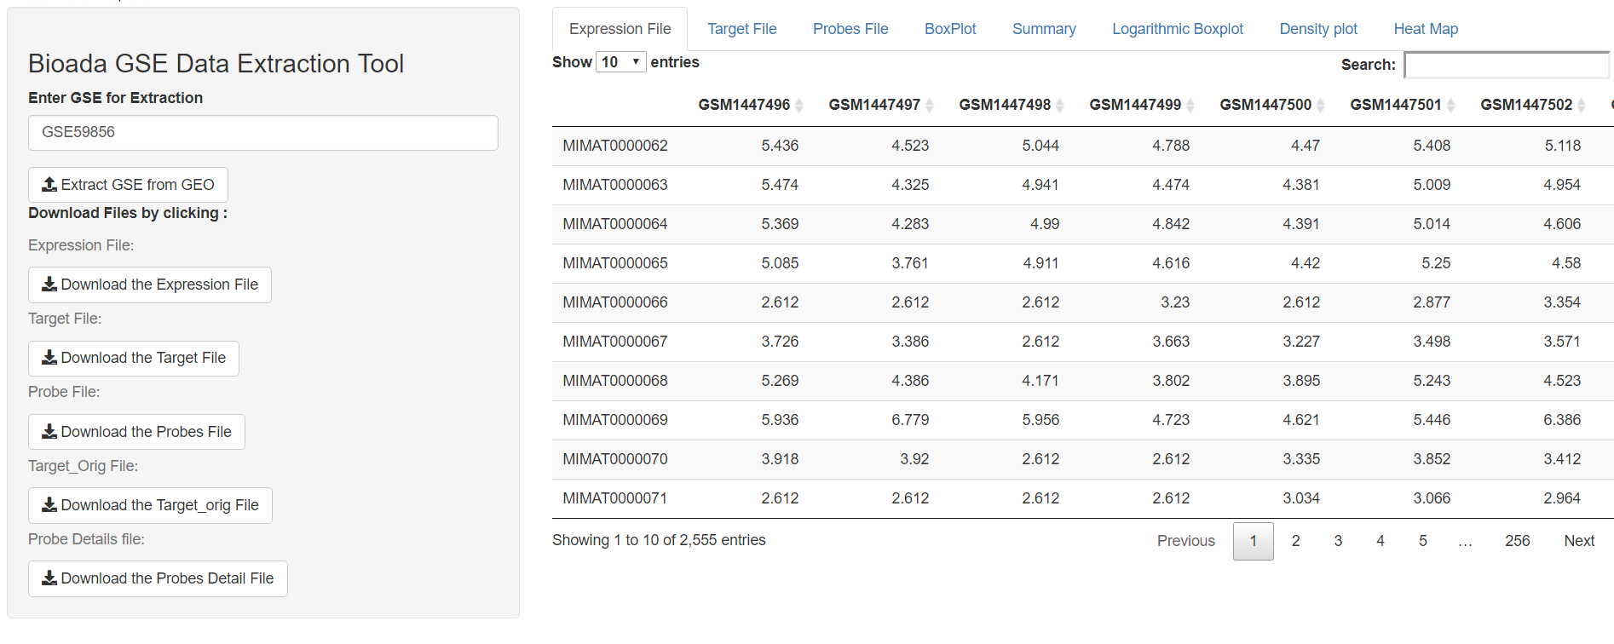
Step 2 - Data Preparation

Slide 19
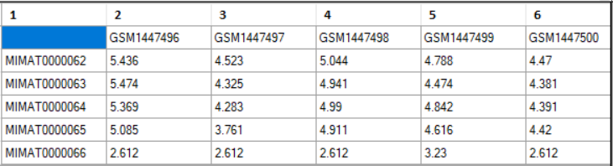
Step 2 - Data Preparation
Expression File

Slide 20
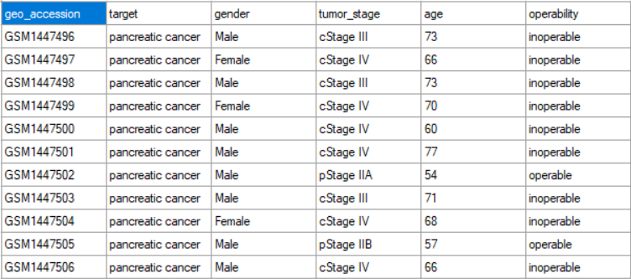
Step 2 - Data Preparation
Target File.

Slide 21
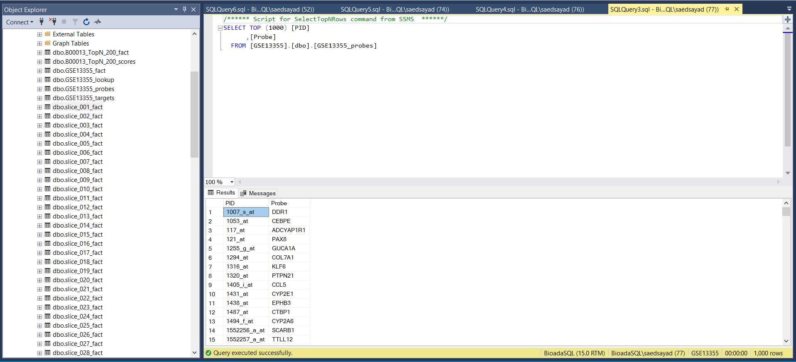
Step 2 - Data Preparation Database Management System - Probes

Slide 22
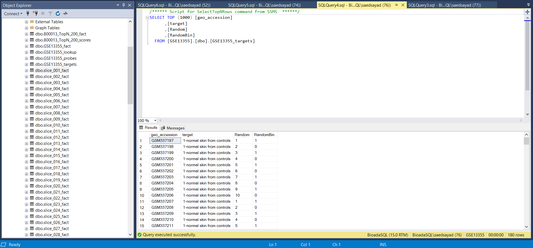
Step 2 - Data Preparation Database Management System - Targets

Slide 23
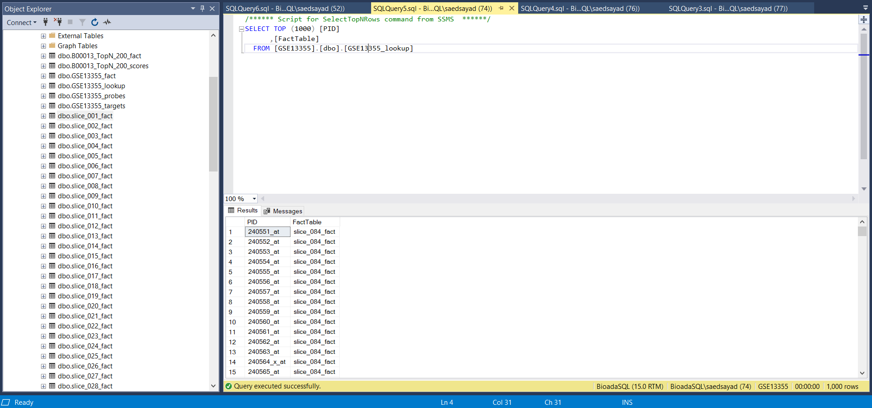
Step 2 - Data Preparation Database Management System - Lookup Table

Slide 24
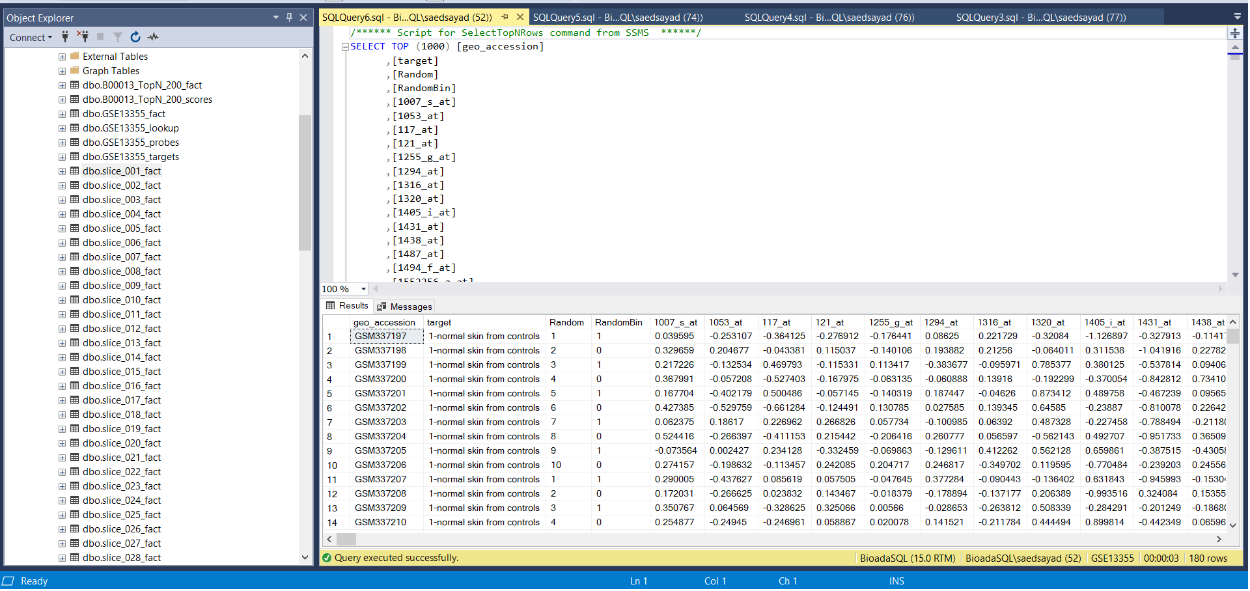
Step 2 - Data Preparation Database Management System - Fact Tables

Slide 25
Step 3 - Data Exploration Interactive Visualization & Statistical Analysis
Univariate Charts
Bivariate Charts
Manhattan Charts – (Will be shown in subsequent slides)
Descriptive Statistical Tests
Inferential Statistical Tests

Slide 26
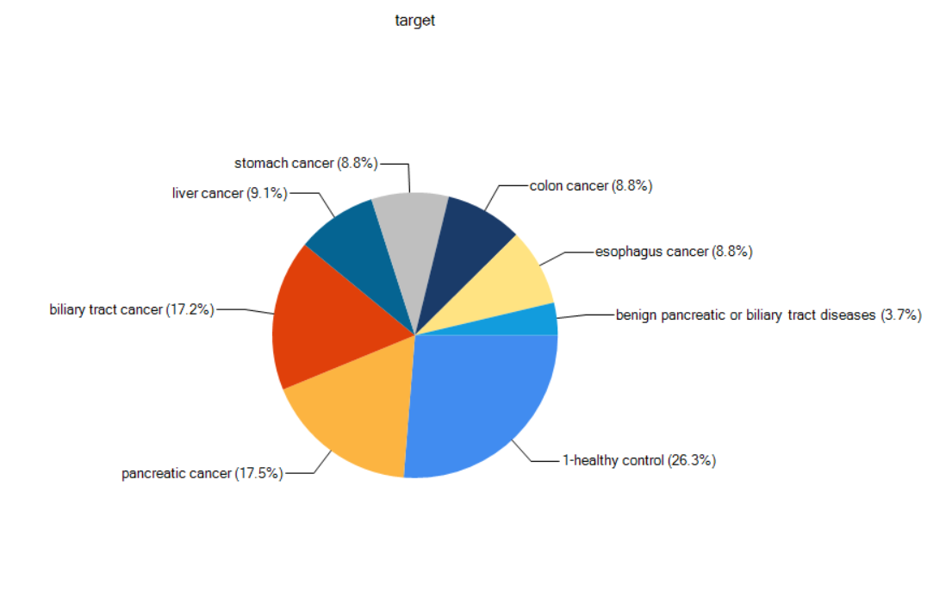
Step 3 - Data Exploration (Contd)
Univariate Analysis:
Only one variable is involved.
It doesn’t deal with relationship with other variables.
Major purpose is to describe and summarize the data.
Ex: Figure shows the analysis for “target” variable.

Slide 27
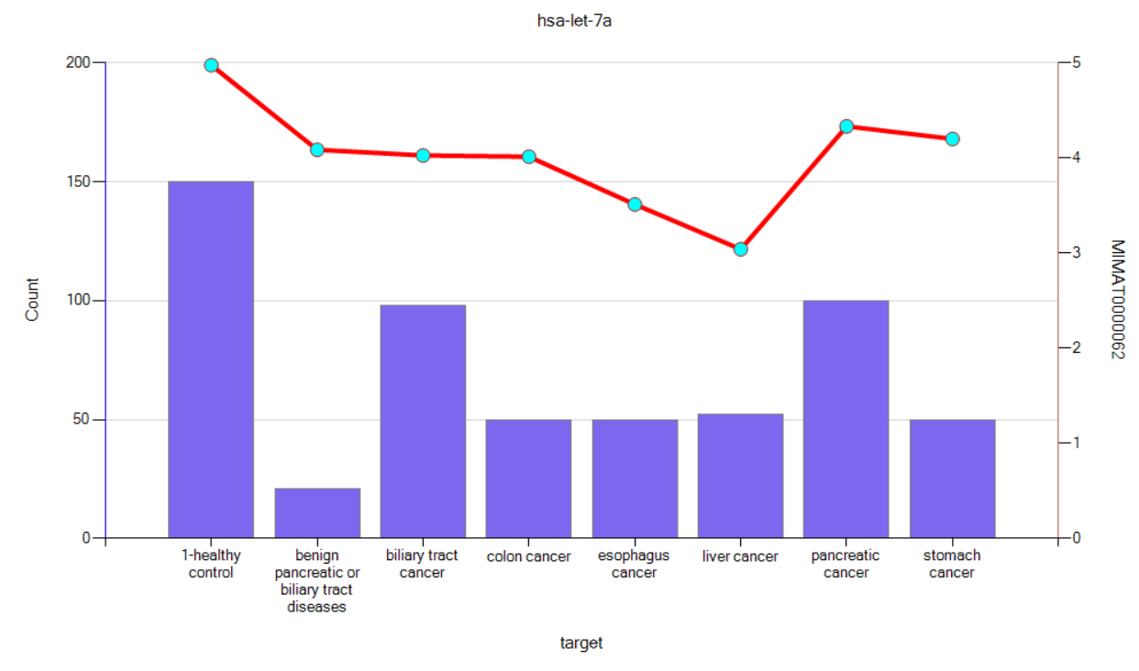
Step 3 - Data Exploration (Contd)
Bivariate Analysis:
Two variables are involved.
It is used to find out if there is relationship between two sets of values.
Ex: Figure shows the bivariate analysis between target & one of the probes.

Slide 28
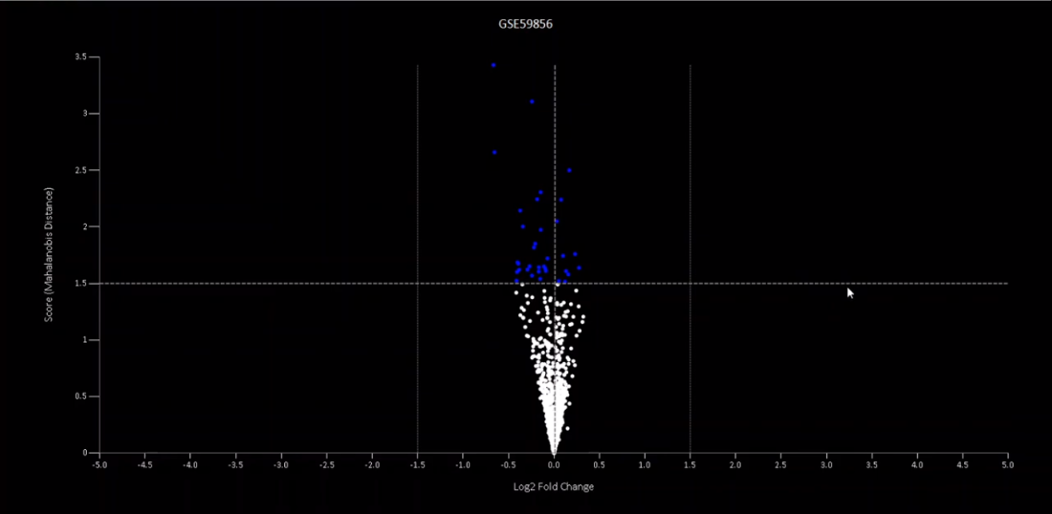
Step 3 - Data Exploration (Contd)
Volcano Plot:
Based on predictability power, we select top N variables out of M (N<<M), basically we are narrowing down the feature space.
Dotted line is for FDR = 0.05. (FDR stands for false discovery rate)
Blue points show all the variables (here probes) with the significant predictability power.
And we will select such N variables to train our model.

Slide 29
Step 4 - Data Modelling
Input Variables Selection
Classification and Regression Models
Save model

Slide 30
Algorithms
Classification:
Linear Discriminant Analysis (LDA)
Regression:
Multiple Linear Regression (MLR)

Slide 31
Linear Discriminant Analysis
We could use Logistic Regression for multiple class, but it has some limitations.
Majorly intended for binary classes, not commonly used for multi-class classification.
It generally becomes unstable when classes are well separated.
Also, it becomes unstable when you have few examples to estimate and learn parameters.
Hence, if you have more than two classes, then LDA is used for classification.

Slide 32
Linear Discriminant Analysis (Contd).
Code snippet to train the LDA model in R:
model.LDA <- lda(target_factor ~., data=train)
Code snippet to test the LDA model in R:
predictions <- predict(model.LDA, newdata=test)

Slide 33
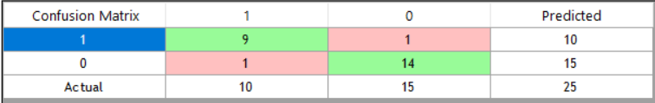
Linear Discriminant Analysis (Contd).
Confusion matrix:
Figure shows the output generated by the LDA model.
It has predicted 1 false data point for both the classes.

Slide 34
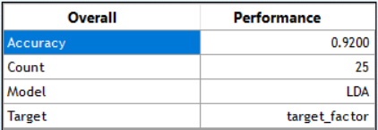
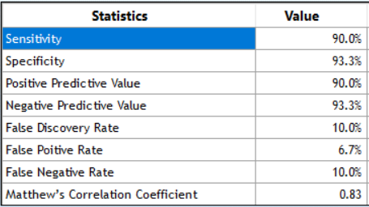
Linear Discriminant Analysis (Contd).
First figure shows the summary of the model training.
Model’s accuracy is 92%.
Second figure shows the different evaluation metrics which will be used to depict the performance of the model.

Slide 35
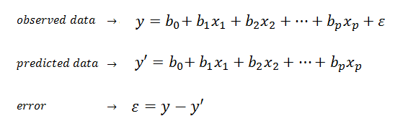
Multiple Linear Regression
Goal of multiple linear regression is to model linear relationship between one or more explanatory (independent) variables and response (dependent) variable.

Slide 36
Multiple Linear Regression (Contd)
Code snippet to train the MLR model in R:
model.MLR <- lm(target_var ~., data=train)
Code snippet to test the MLR model in R:
predictions <- predict(model.MLR, newdata=test)

Slide 37
Step 3 - Data Exploration Interactive Visualization & Statistical Analysis
Univariate charts
Bivariate charts
Volcano, Manhattan & t-SNE plots
Descriptive Statistical tests
Inferential Statistical tests
Notes:
But a good DBMS alone may not be sufficient to aid the genomic studies, because, The huge genomic data is not readily readable and can’t be explored manually in a short time. Neither, training scientists with a programming language and other Computer studies would help.
That’s why we added Interactive visualizations & Statistical Analysis to SmartArray It can give you - Univariate and Bivariate analysis as charts - and Volcano, Manhattan and t-SNE plots - it provides a wide range of Descriptive & inferential statistical tests Like ANOVA, t-test, Kai-square test, etc. - Also provides correlation & simulation analysis - and promotes pathway & gene ontology enrichment.

Slide 38
Univariate Analysis
Numerical Attributes.
Attributes : Intensity of each probes.
Categorical Attributes.
Attributes: Cancer type, Disease (Yes/ No) etc.
Binned Numerical Attributes for Visualization.
Attributes: RandomBin.
Statistics and Visualization same as that of categorical attributes.

Slide 39
Statistics - Numerical Univariate Analysis
Mean.
Standard Deviation.
SEM (Standard Error of mean).
Lower Bound.
Upper Bound.
Count.

Slide 40
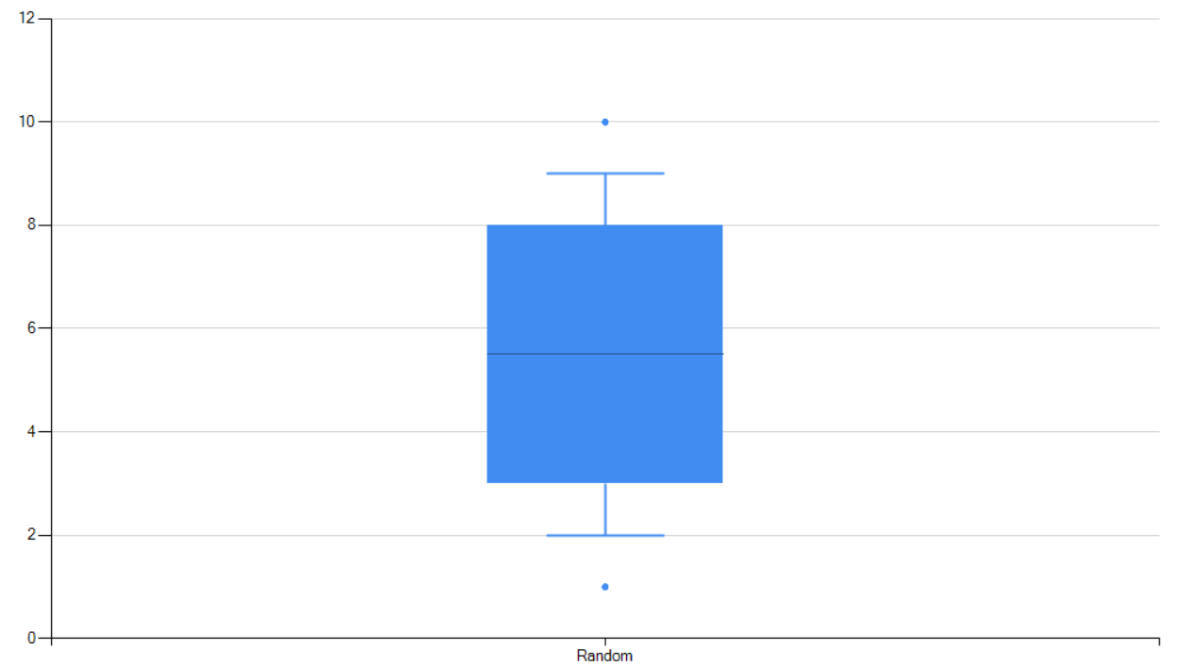
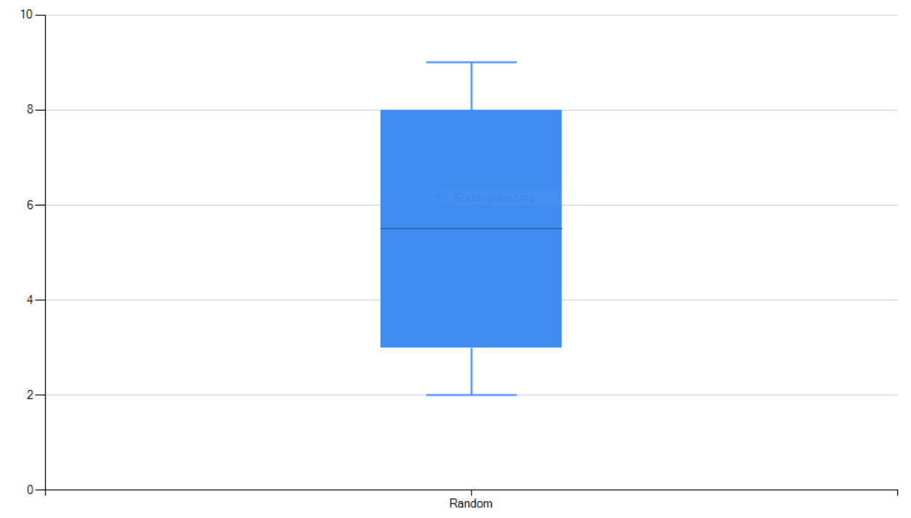
Visualization - Numerical Univariate Analysis
Box Plot with Outliers:
Box Plot without Outliers:
Gene Activity
Gene Activity

Slide 41
Statistics - Categorical Univariate Analysis
Count of each categories.
Count % of each categories.

Slide 42
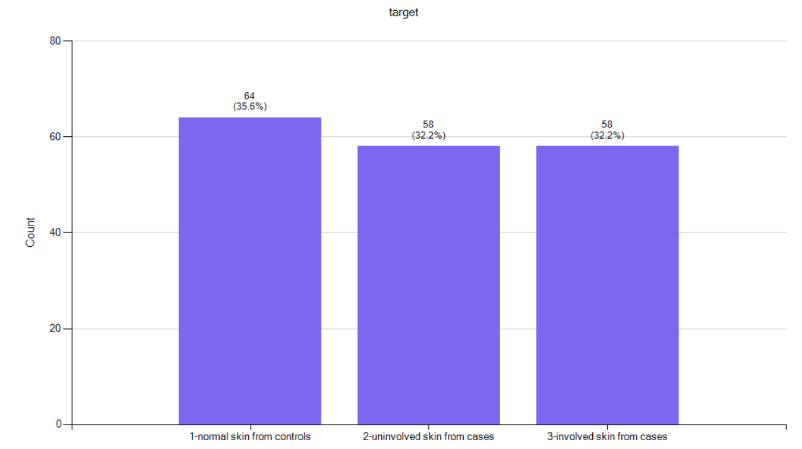
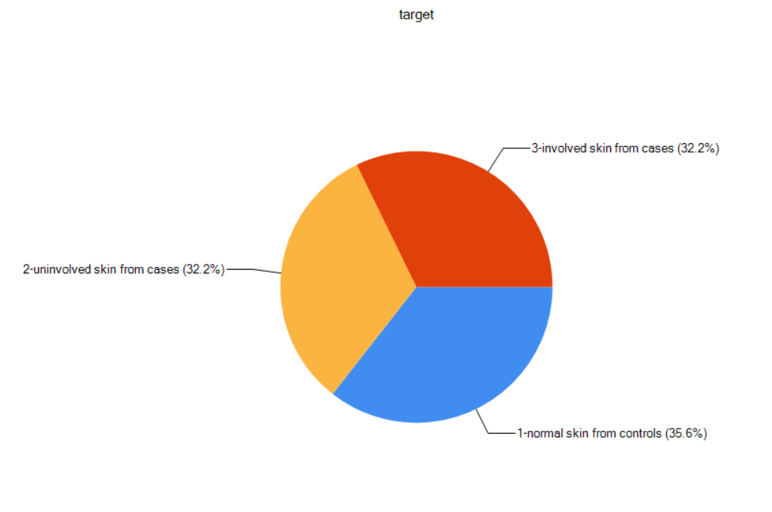
Visualization -Categorical Univariate Analysis
Bar Chart:
Pie Chart:

Slide 43
Bivariate Analysis
Numerical and Numerical Attributes.
Categorical and Categorical Attributes.
Numerical and Categorical Attributes.
Binned and Numerical Attributes.

Slide 44
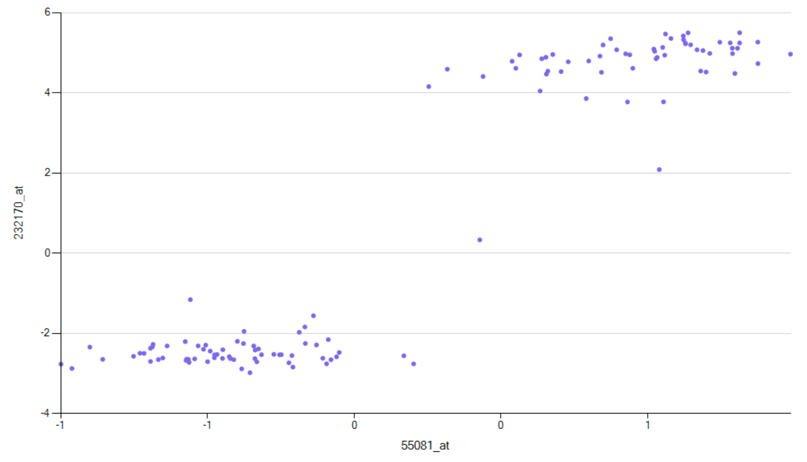
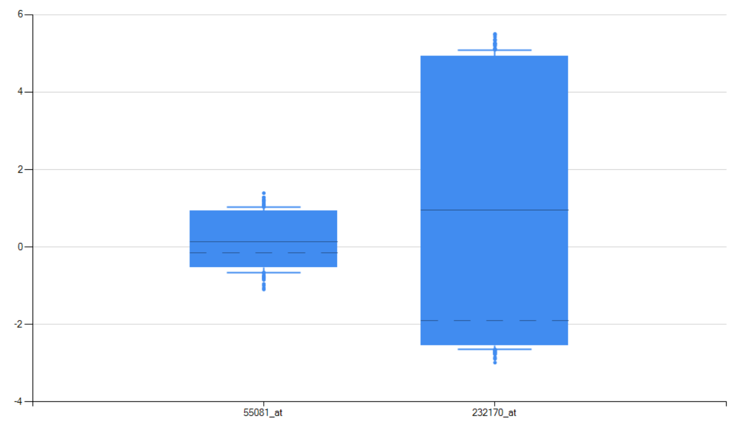
Statistics :
Numerical and Numerical Bivariate Analysis
Visualization :
Statistic calculated: Correlation
Scatter Plot:
Box Plot:
Gene Activity

Slide 45
Statistics :
Categorical and Categorical Bivariate Analysis
Statistics used:
Chi-Squared Test (returns: Chi-Squared Value & Degree of Freedom).
Chi-Squared Distribution (returns: p-value).
Rho value ( Rank Correlation Coefficient).
Count.

Slide 46
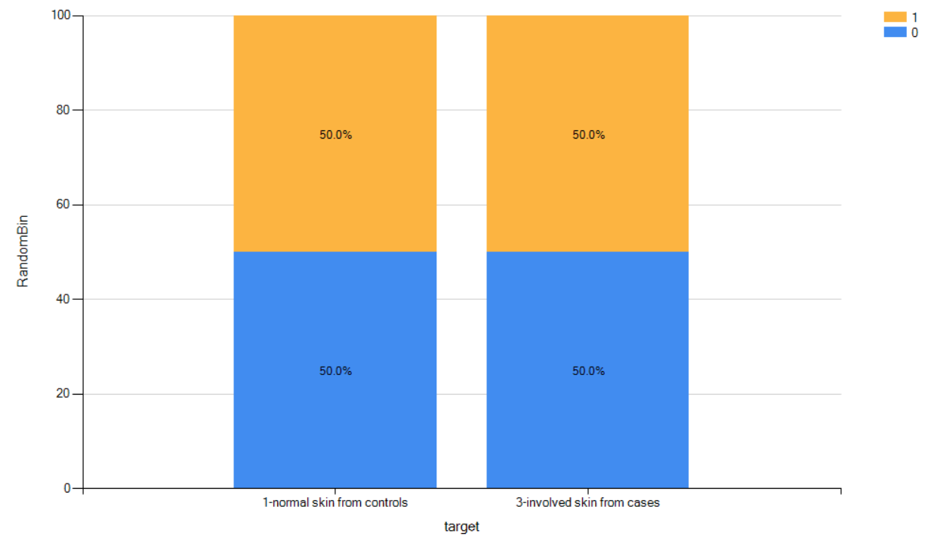
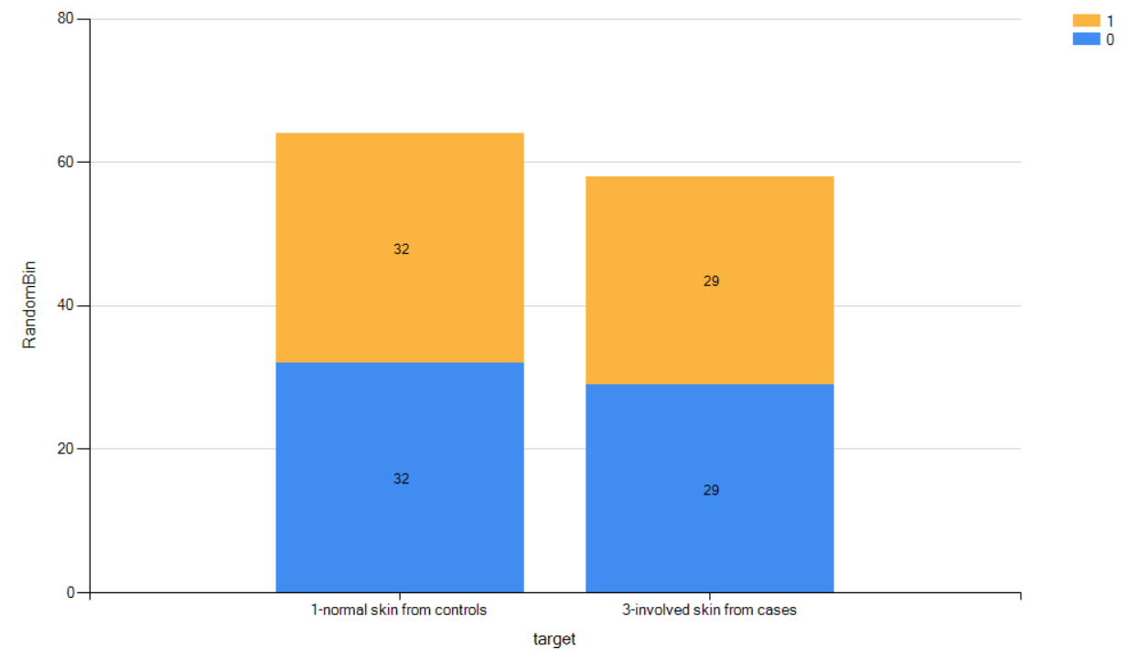
Visualization:
Categorical and Categorical Bivariate Analysis.
Stacked Bar Chart: with Count %
Stacked Bar Chart: with count

Slide 47
Statistics :
Categorical and Numerical Bivariate Analysis
Statistics used:
T-test with both equal variance and unequal variance.
Degree of Freedom.
p-value.
Count.

Slide 48
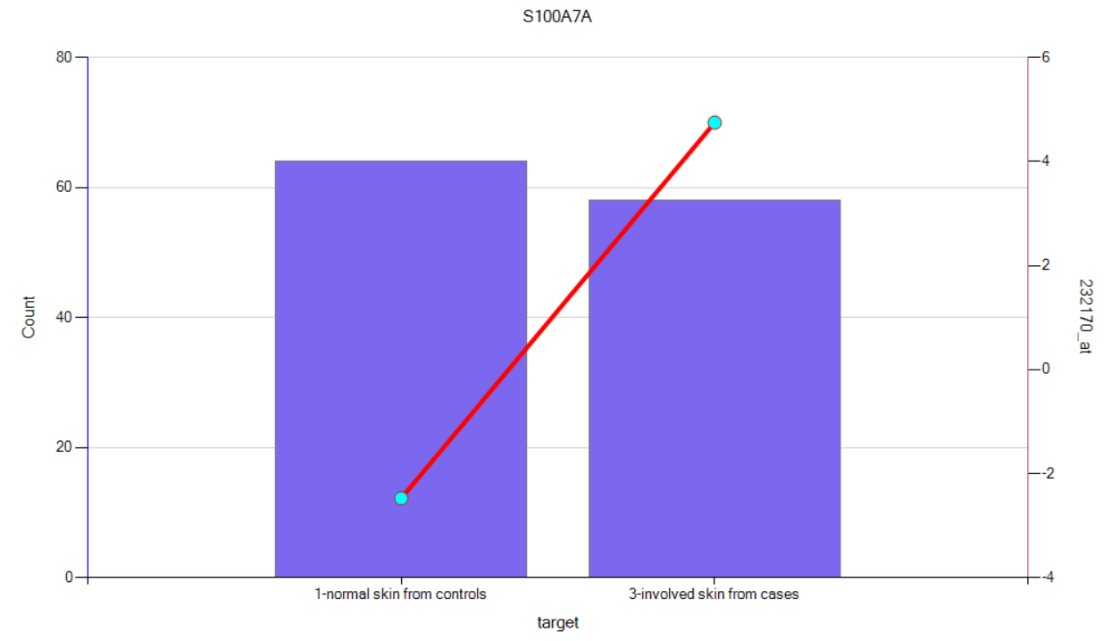
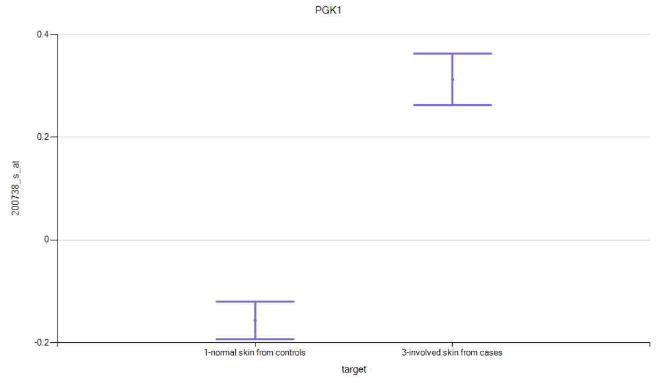
Visualization:
Categorical and Numerical Bivariate Analysis.
We will be using two type of plots for the visualization:
Line Chart + Bar chart:
Confidence Interval:

Slide 49
Additional Exploration:
Filters to filter out data based on categories.
To perform one-hot encoding on the categorical attributes.
To select top-N probes and store in the database.

Slide 50
Step 4 - Data Modeling
Classification and regression models
Automated variable selection
Federated Machine Learning
Save model
Generate model script in Java, SQL, Python and VB.

Slide 51
Modelling Algorithm - XGBoost
Implementation of Gradient Boosting Decision Tree Algorithm.
Input Parameters are
1. Independent & Dependent Variables (Train Set)
2. Loss Function (RMSE for Regression & Log Loss for Classification)
3. Number of iterations

Slide 52
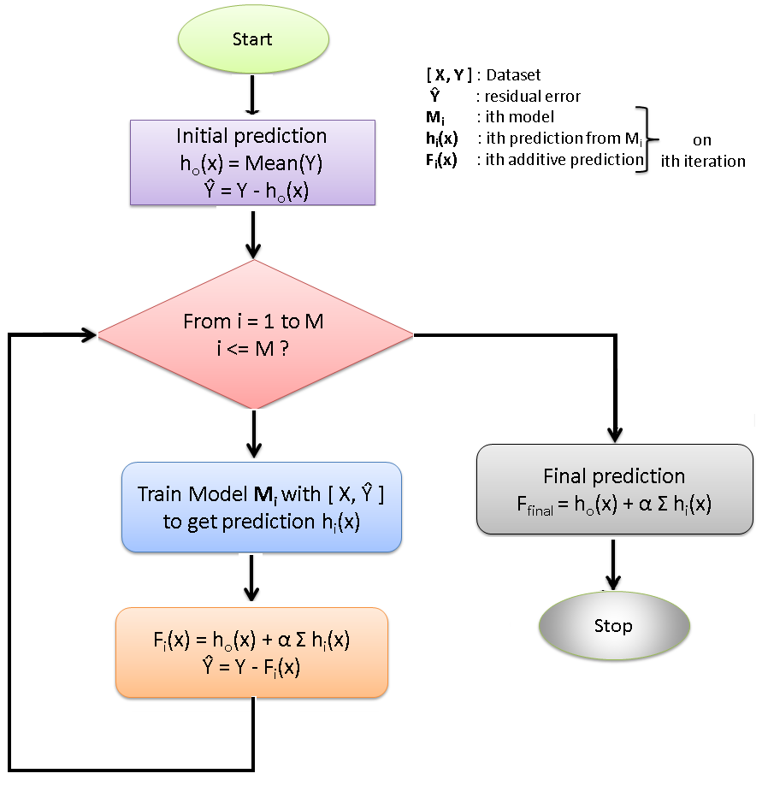
Gradient Boosting Algorithm

Slide 53
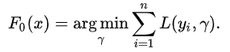
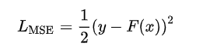
Gradient Boosting Algorithm
We create a Base Model for the input Data.
Consider Example of regression model using MSE as the Loss function.
Y is the true/observed value ( Available from Input Data)
F(x) is the Expected value and calculated by equating the first order derivative of Loss function to Zero.

Slide 54
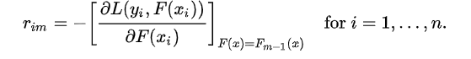
Gradient Boosting Algorithm
Compute the Pseudo residuals at each step.
For the previous example, the pseudo residual is = (y – F(x))
Fit: The base model(a Decision Tree)
Predictions: pseudo residuals.
Given: Learning rate from the previous output predictions.
Iterate: M times until the required number of models are built.
Final prediction: The additive sum of all previous predictions.

Slide 55
Modelling Algorithm - XGBoost
XGBoost uses more accurate approximations by employing
Second-order gradients, and
Advanced regularization.
We make a residual base model by setting the “base_score” hyper parameter value.

Slide 56
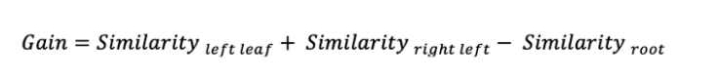
Modelling Algorithm - XGBoost
Finding optimal split in DT: For all the constructed decision trees, calculate
Similarity weights
Gain
Output values are calculated only for leaves of a tree.

Slide 57
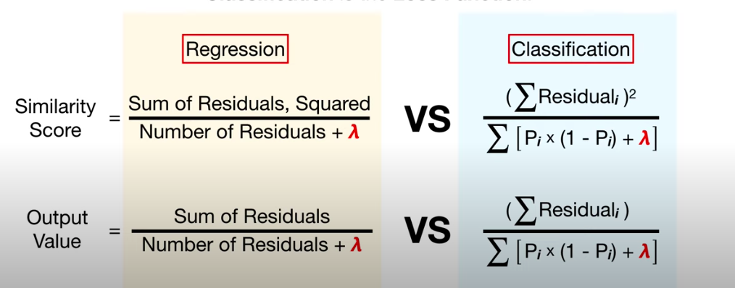
Modelling Algorithm - XGBoost

Slide 58
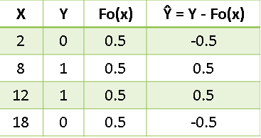
Modelling Algorithm - XGBoost
Consider the following data table :
X is input variable
Y is the output variable
Here the initial prediction / base_score is 0.5 for all data points that is Fo(X)
And the last column is the residuals for all data points.

Slide 59
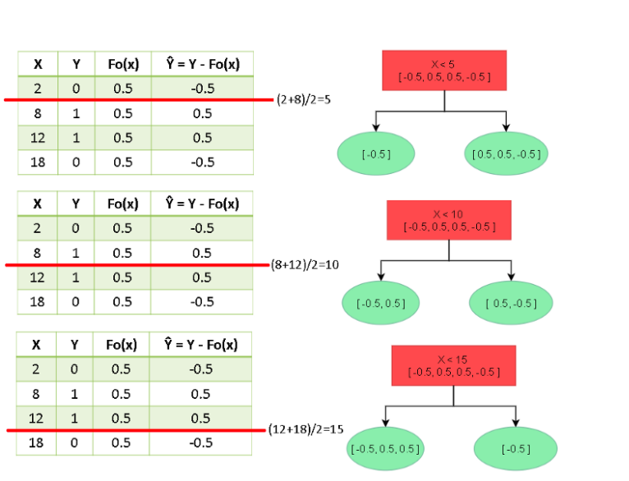
Modelling Algorithm - XGBoost
Notes:
The trees are constructed by splitting data into two partitions of various possible splits.

Slide 60
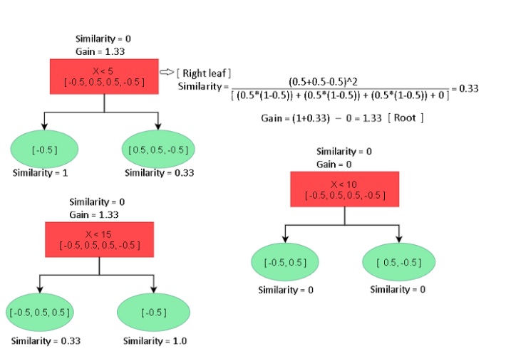
Modelling Algorithm - XGBoost
Notes:
Choose the tree which has maximum Gain, let’s choose X <15 tree which has max Gain of 1.33. Further split till a value of max_depth for complete tree construction.

Slide 61
XGBoost - Hyperparameters
General Parameters
Silent
Silent mode is activated is set to 1, ⇒ no running messages will be printed.
Good to set it to 0 ⇒ messages might help in understanding the model.
nthread [default to maximum number of threads available if not set
Used for parallel processing
Number of cores in the system can be specified. ⇒ Otherwise, cores will detected automatically.

Slide 62
XGBoost - Hyperparameters
Booster Parameters
min_child_weight
The minimum sum of weights of all observations required in a child.
Used to control over-fitting.
max_depth
The maximum depth of a tree.
Base_score
The initial prediction score of all instances.

Slide 63
XGBoost - Hyperparameters
Booster Parameters
gamma
A node is split only when the resulting split gives a positive reduction in the loss function.
Specifies the minimum loss reduction required to make a split.
subsample
It denotes the fraction of observations to be randomly samples for each tree.
Subsample ratio of the training instances.

Slide 64
XGBoost - Hyperparameters
Booster Parameters
alpha
L1 regularization term on weights.
lambda
L2 regularization term on weights .

Slide 65
Step 5 - Model Evaluation
Extensive model evaluation using
Confusion matrix
K-S, Gain, Lift, ROC Charts
Histogram

Slide 66
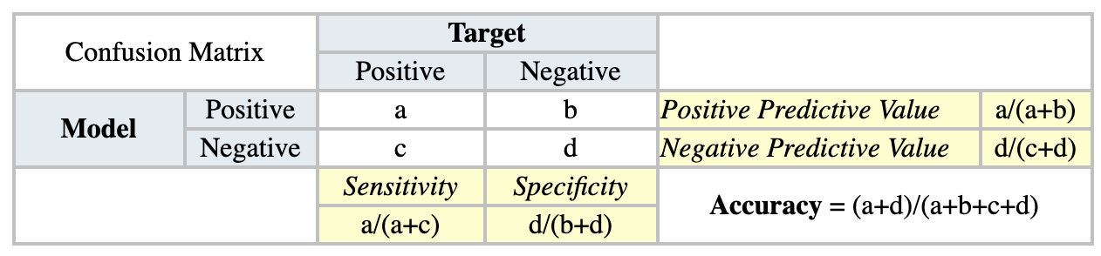
Step 5 - Model Evaluation
Confusion Matrix: It shows the number of correct and incorrect predictions made by the classification model compared to the actual outcomes (target value) in the data.

Slide 67
Step 5 - Model Evaluation
Accuracy : The proportion of the total number of predictions that were correct.
Precision : The proportion of positive cases that were correctly identified.
Negative Predictive Value : The proportion of negative cases that were correctly identified.
Sensitivity or Recall : The proportion of actual positive cases which are correctly identified.
Specificity : The proportion of actual negative cases which are correctly identified.

Slide 68
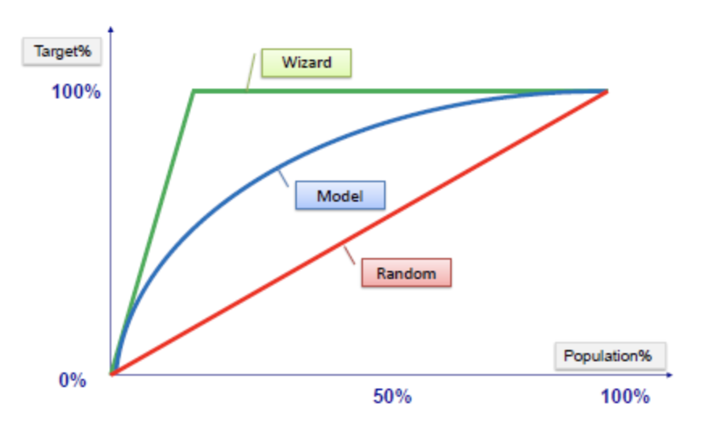
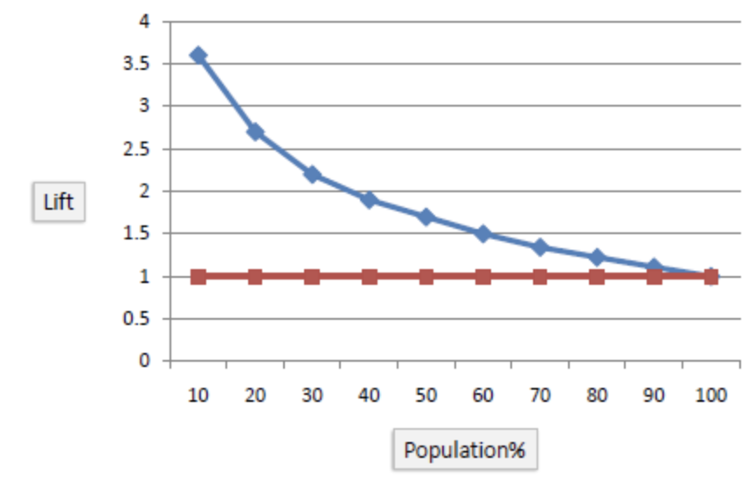
Step 5 - Model Evaluation
Gain Chart
Gain and Lift Charts:
The ratio between the results obtained with and without the model.
Evaluates model performance in a portion of the population.
The lift chart shows how much more likely we are to receive positive responses than if we contact a random sample of customers.
Lift Chart

Slide 69
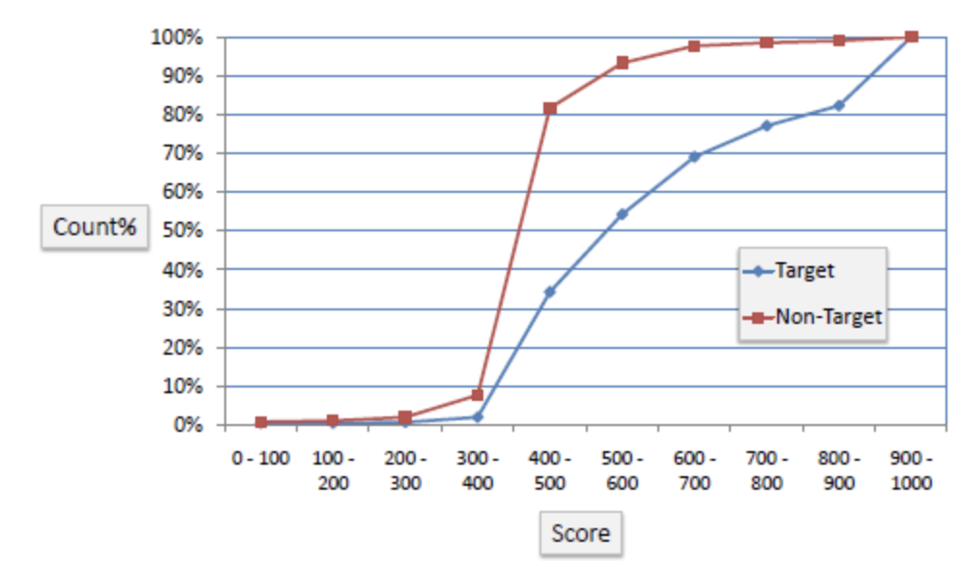
Step 5 - Model Evaluation
K-S Chart:
K-S or Kolmogorov-Smirnov chart is a measure of the degree of separation between the positive and negative distributions.
The K-S is 100 if the scores partition the population into two separate groups positive and negative.
The K-S is 0 if the model selects cases randomly from the population.
K-S Chart

Slide 70
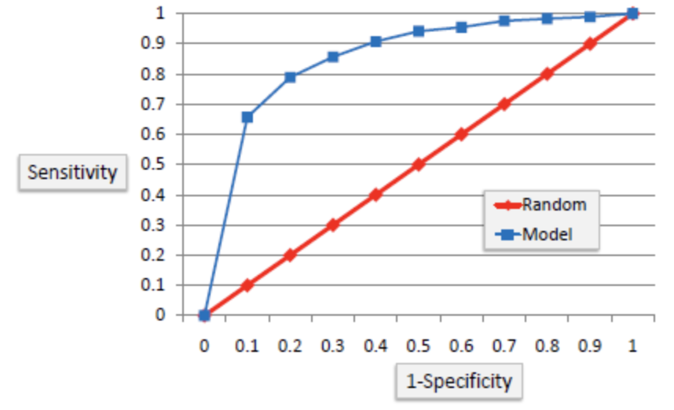
Step 5 - Model Evaluation
ROC Chart
Shows false positive rate (1-specificity) on X-axis, the probability of target=1 when its true value is 0, against true positive rate (sensitivity) on Y-axis, the probability of target=1 when its true value is 1.
The curve will climb quickly toward the top-left meaning the model correctly predicted the cases.
ROC Chart

Slide 71
Step 5 - Model Evaluation
AUC
Area under ROC curve is often used as a measure of quality of the classification models.
A random classifier has an area under the curve of 0.5, while AUC for a perfect classifier is equal to 1.
In practice, most of the classification models have an AUC between 0.5 and 1.
ROC Chart

Slide 72
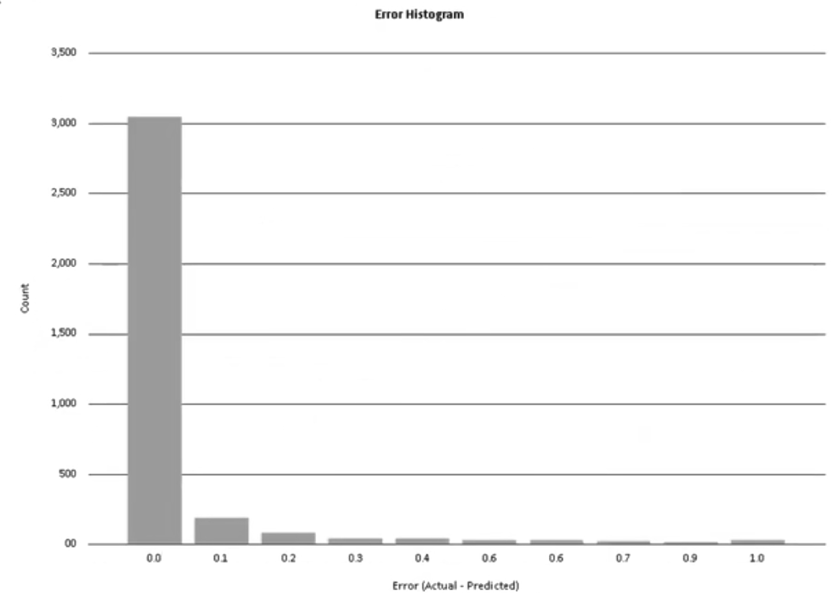
Step 5 - Model Evaluation
Histogram
For regression models, an error histogram can cleary help us evaluate the model by plotting Error (Actual - Predicted) vs. Count.

Slide 73
Step 6 - Model Deployment
After careful evaluation, the generated model can be deployed to an IIS server.
Notes:
Taking SmartArray’s power packed output as input,
Xarang, is a tool, which adopts Machine learning methods to model, evaluate and predict PRS and Biomarkers discovery.
This tool has the flexibility to
access data on various sources like from local disks, databases, or cloud.
It can generate classification or regression models Depending on the nature of data being categorical or numerical.
It provides automated variable selection
For extensive model evaluation
And it can deploy this model in a single click
Overall Xarang is a Federated machine learning tool
Moving on to our final product...

Slide 74
Bioada Platform
Notes:
Here is what we have to offer, our Bioada Platform...

Slide 75
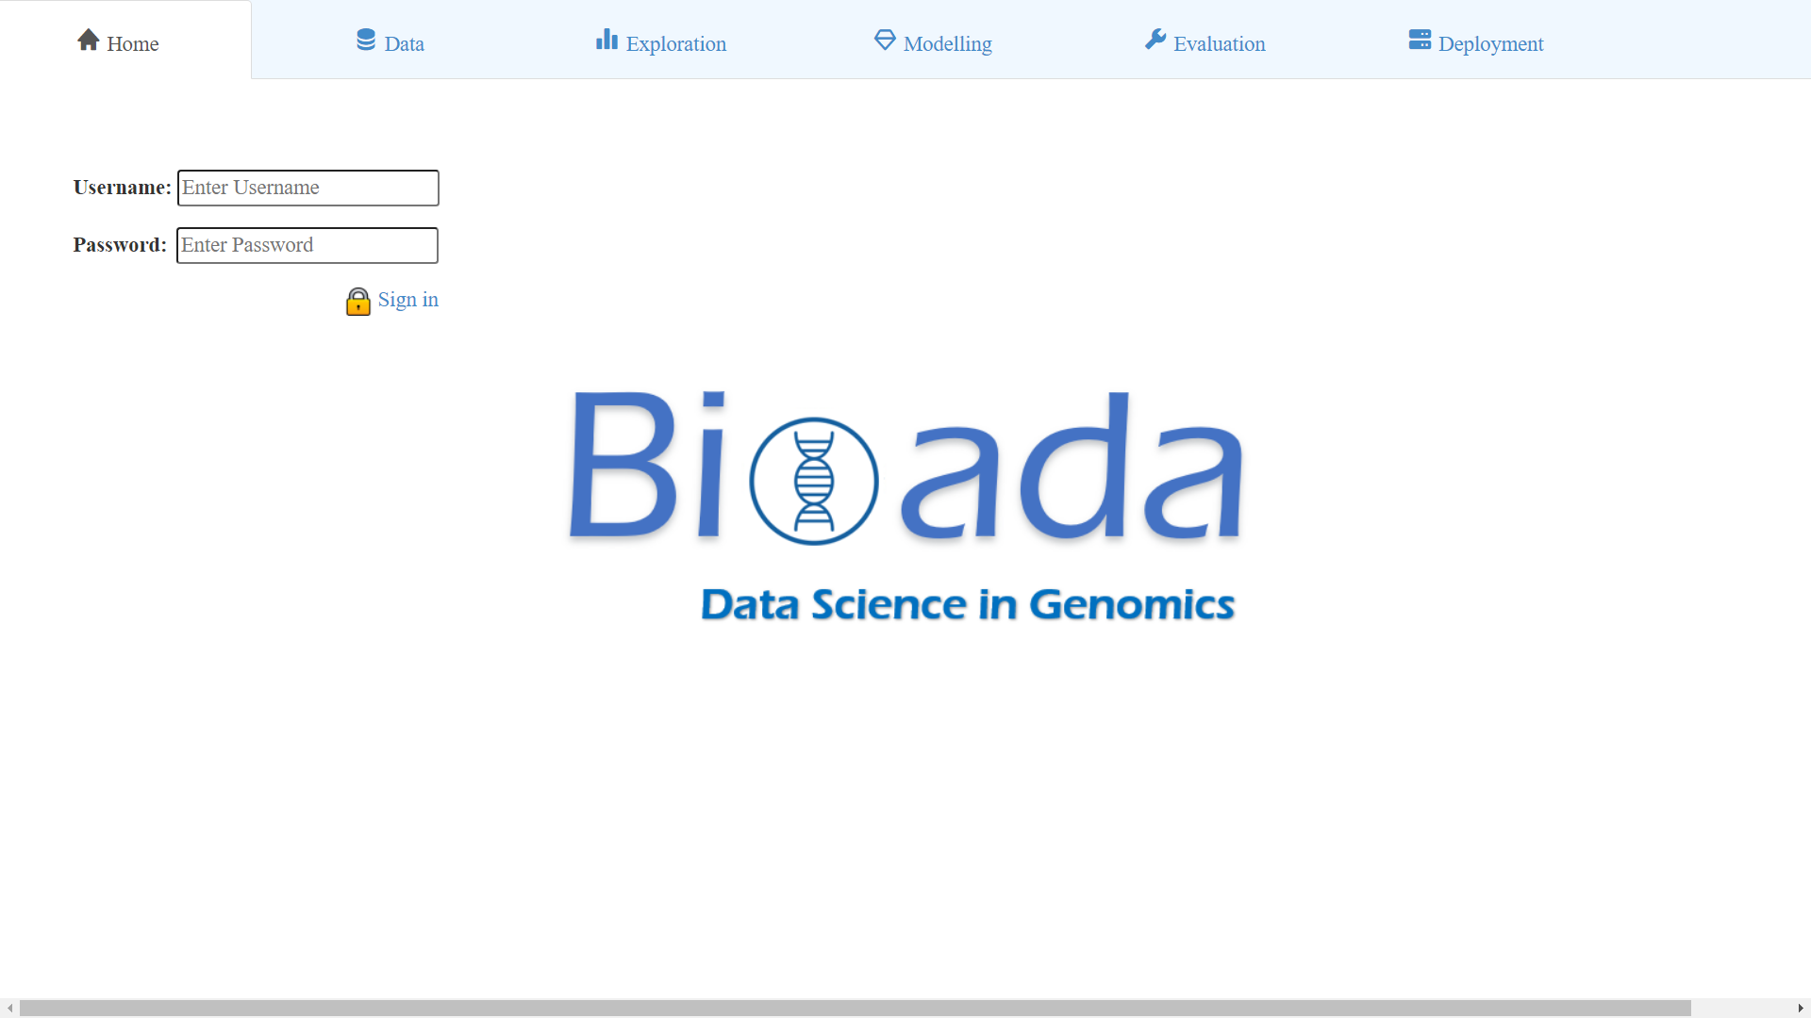
Notes:
Here is what we have to offer, our Bioada Platform...

Slide 76
Thank You!
Learn more at
www.bioada.com
Q&A

